Slide 1
Analytics for a Better World Recitation 5

Slide 2
Schedule
Homework
Quick Topic Review
Working through an application

Slide 3
Homework
Homework 2 feedback… has been delayed. So sorry!
Homework 3 is released
Focuses on modeling and coding for two problems
Simplified Ocean Plastic Clean Up (related to shortest paths from Dike Height Optimization)
Blood bank distribution center locations (related to local search heuristic from hospital locations in Timor-Leste)
Due March 14th

Slide 4
Topic Review
Past Week:
Lecture 10 Healthcare Accessibility via Road Network Improvement
Lecture 9 Hospital Location Optimization in Timor-Leste
Earlier:
Lecture 8 Dike Height Optimization
Lecture 7 Locations of UN Humanitarian Response Depots
Lecture 6 HDR Brachytherapy Treatment
Lecture 5 Cattle Feed for Small Farmers
Lecture 4 Integer Optimization
Lecture 3 World Food Program
Lecture 2 Linear Optimization
Lecture 1 Introduction

Slide 5
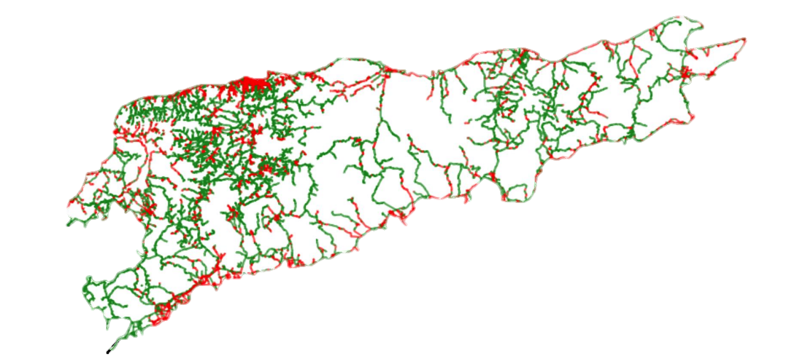
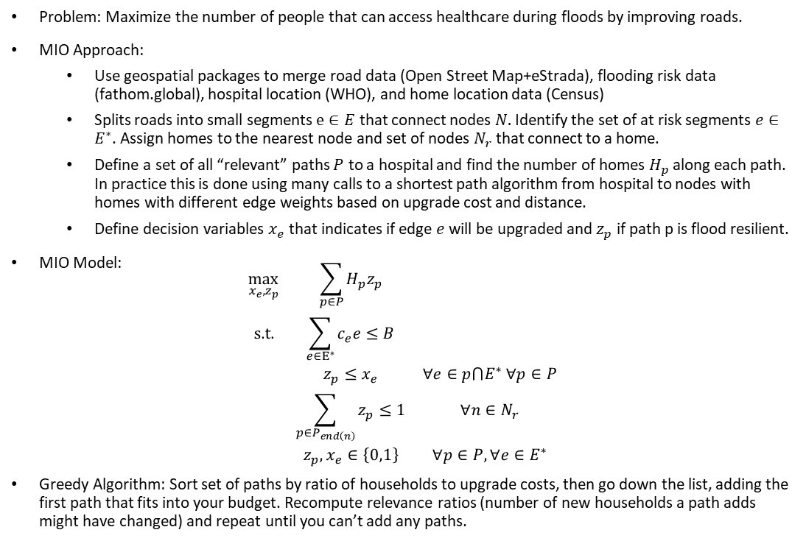
Lecture 10 Healthcare Accessibility via Road Improvement
Problem: Maximize the number of people that can access healthcare during floods by improving roads.
MIO Approach:
Use geospatial packages to merge road data (Open Street Map+eStrada), flooding risk data (fathom.global), hospital location (WHO), and home location data (Census)
Splits roads into small segments $e∈E$ that connect nodes $N.$ Identify the set of at risk segments $e∈E^{∗}$. Assign homes to the nearest node and set of nodes $N_{r}$ that connect to a home.
Define a set of all “relevant” paths $P$ to a hospital and find the number of homes $H_{p}$along each path. In practice this is done using many calls to a shortest path algorithm from hospital to nodes with homes with different edge weights based on upgrade cost and distance.
Define decision variables $x_{e}$ that indicates if edge $e$ will be upgraded and $z_{p}$ if path p is flood resilient.
MIO Model:
$$\begin{matrix}\max_{x_{e},z_{p}} & \sum_{p∈P}{H_{p}z_{p}} & \\ \text{s}\text{.}\text{t}\text{.} & \sum_{e∈E^{∗}}{c_{e}e}≤B & \\ & z_{p}≤x_{e} & ∀e∈p⋂E^{∗} ∀p∈P \\ & \sum_{p∈P_{end\left(n\right)}}{z_{p}≤1} & ∀n∈N_{r} \\ & z_{p},x_{e}∈\left\{0,1\right\} & ∀p∈P, ∀e∈E^{∗}\end{matrix}$$
Greedy Algorithm: Sort set of paths by ratio of households to upgrade costs, then go down the list, adding the first path that fits into your budget. Recompute relevance ratios (number of new households a path adds might have changed) and repeat until you can’t add any paths.

Slide 6
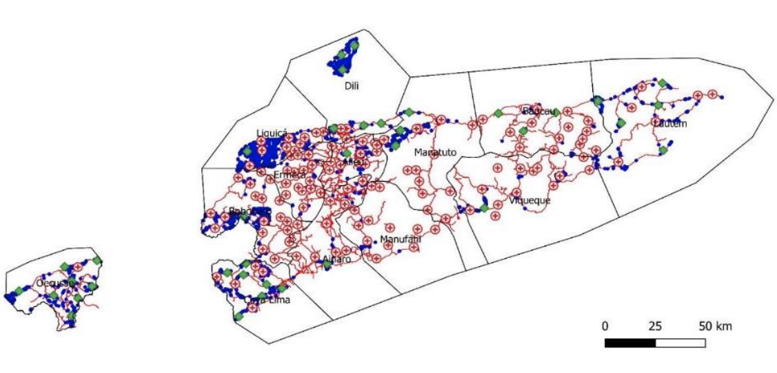
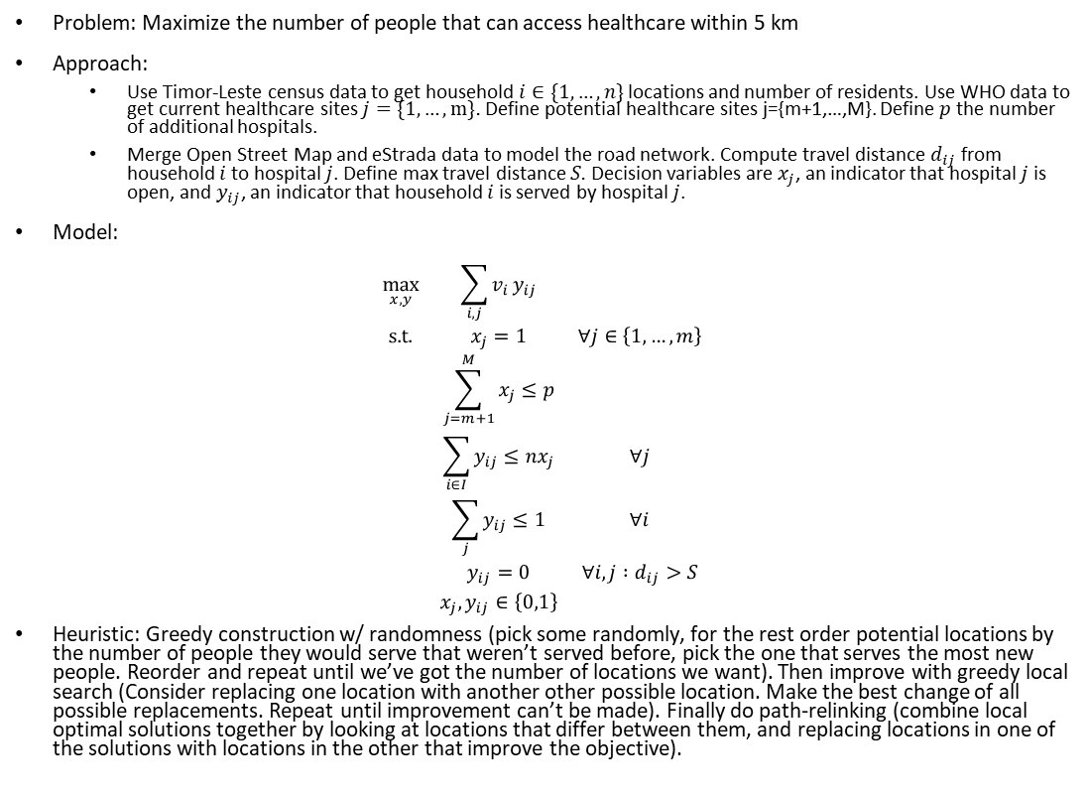
Lecture 9 Hospital Location Optimization in Timor-Leste
Problem: Maximize the number of people that can access healthcare within 5 km
Approach:
Use Timor-Leste census data to get household $i∈\{1,…,n\}$ locations and number of residents. Use WHO data to get current healthcare sites $j=\{1,…,m\}.$ Define potential healthcare sites j={m+1,…,M}. Define $p$ the number of additional hospitals.
Merge Open Street Map and eStrada data to model the road network. Compute travel distance $d_{ij}$ from household $i$ to hospital $j$. Define max travel distance $S.$ Decision variables are $x_{j}$, an indicator that hospital $j$ is open, and $y_{ij}$, an indicator that household $i$ is served by hospital $j$.
Model:
$$\begin{matrix}\max_{x,y} & \sum_{i,j}{v_{i}}y_{ij} & \\ \text{s}\text{.}\text{t}\text{.} & x_{j}=1 & ∀j∈\left\{1,…,m\right\} \\ & \sum_{j=m+1}^{M}{x_{j}}≤p & \\ & \sum_{i∈I}{y_{ij}}≤nx_{j} & ∀j \\ & \sum_{j}{y_{ij}≤1} & ∀i \\ & y_{ij}=0 & ∀i,j :d_{ij}>S \\ & x_{j},y_{ij}∈\left\{0,1\right\} & \end{matrix}$$
Heuristic: Greedy construction w/ randomness (pick some randomly, for the rest order potential locations by the number of people they would serve that weren’t served before, pick the one that serves the most new people. Reorder and repeat until we’ve got the number of locations we want). Then improve with greedy local search (Consider replacing one location with another other possible location. Make the best change of all possible replacements. Repeat until improvement can’t be made). Finally do path-relinking (combine local optimal solutions together by looking at locations that differ between them, and replacing locations in one of the solutions with locations in the other that improve the objective).

Slide 7
Now let’s workshop a problem that hasn’t been solved yet…

Slide 8
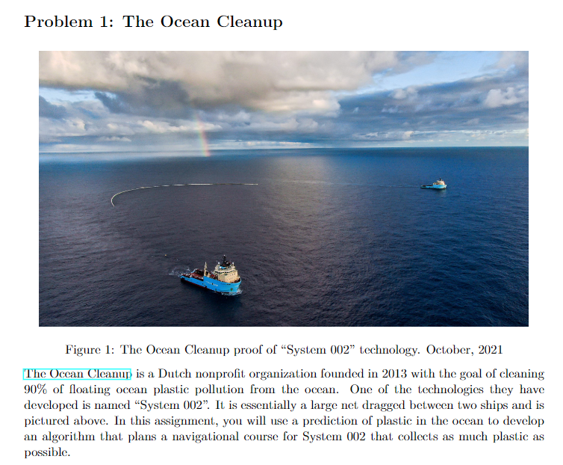

Slide 9
How would you create a navigation planner using optimization?
DATA: What data would you like/need? Where might it come from? How could it be represented? How might you need to process it? What are the relevant software tools?
CONSTRAINTS: What might the limits on your navigation course be? How would you formulate them algebraically?
DECISION VARIABLES: Decide on your decision variables.
OBJECTIVE: What goal do you suggest?

